Slide 1
HOST ORDER EFFECT ON VIRUS SEGMENTATION
EEB313: Juwon (Lucia) Park, Yuehan (Anna) Li , Cindy Yu

Slide 2
WHY STUDY THIS?
Segmented viruses pose a significant risk
Understanding the role of host order helps us identify patterns that influence susceptibility
This research can help with future viral outbreaks
Notes:
Before diving in, I will briefly explain why we decided to study this topic. Segmented viruses pose a significant risk because their genome organization allows them to adapt rapidly, enabling cross-species transmission and increasing their potential for zoonotic viruses. Understanding the role of host order can help us identify patterns that influence susceptibility across mammalian species, providing insights to disease emergence and evolution. This research could help predict and mitigate future viral outbreaks.

Slide 3
HYPOTHESIS AND PREDICTION
Notes:
Now I will actually dive into our hypothesis and prediction.

Slide 4
BACKGROUND
VIRUS SEGMENTATION
WHY HOST ORDER?
A viral genome is sometimes split into parts (segmentation)
Enables virus to respond dynamically to host environments
Host order with complex genomes may drive evolution of segmented viral genomes
E.g. Sialic acid receptors
Notes:
I’m going to start by providing a little background info. Segmented virus means its genome is split into parts - this dynamic allows them to respond dynamically to various host environments. And host order,

Slide 5
MAIN HYPOTHESIS
Host order is a significant driver of whether mammal species are more likely to be affected by segmented viruses
Segmented viruses are uniquely equipped to adapt dynamically to the host
Key question: Does host order act as a primary determinant of susceptibility?

Slide 6
PREDICTION
MODEL 1
MODEL 2
1
2
Other predictors
Other predictors
AND
Host order
Model 2 (with host order) will have a lower AIC!

Slide 7
DATA

Slide 8
DATA DESCRIPTION
CLOVER database
Mammal_viruses_Associations
HP3_Virus dataset
Mammal_viruses_Associations
Information on mammalian host order and associated viruses
HP3_Virus
Predictors

Slide 9
Data Cleaning and Integration
Virus name standardized
Lowercase
Underscore
DNA virus excluded
No segmented DNA virus
Host order
Fewer than 40 rows removed
Remove NAs

Slide 10
OTHER PREDICTORS
GENOME LENGTH
CYTOPLASMIC REPLICATION
ENVELOPE
SINGLE/DOUBLE STRAND
ZOONOTIC
1
2
3
4
5
Notes:
Multicollinearity bad, virus family causing multicollinearity → just took it out, its their traits we’re looking
Double stranded = less prone to rapid mutation
RNA viruses only (maybe due to DNA proofreading)
Maybe DNA less segmented because more faithful, doesnt need checkpoints

Slide 11
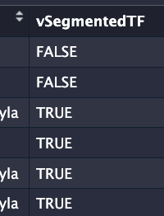
WHY LOGISTIC REGRESSION?
Generalized linear model with BINARY (Bernoulli, binomial) data:
PREDICTORS MEAN OF RESPONSE
Eg. a one-unit change in X_i changes the log-odds of Y (being true) by _______
Notes:
We chose to use GLMs as it allows us to see how a change in predictors affects the mean of a response variable, without needing to follow certain assumptions. Our data is not normally distributed—we have binomial data instead, as a virus can be segmented (a 1) or non-segmented (0)
By using a GLM, we can examine how the likelihood of a virus being segmented changes with increases/decreases in the predictor variables.

Slide 12
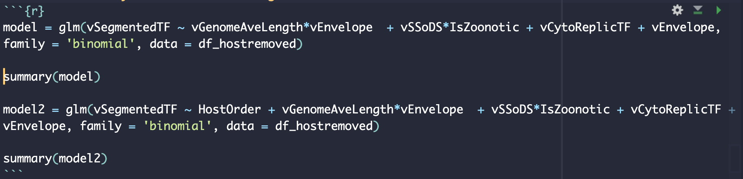
LOGISTIC REGRESSION
Traits interact
Mechanisms not entirely clear:
Genome size constraints, coding for envelopes, rapid mutation rates
Must avoid collinearity
Notes:
Here is a code snippet. There are some interactions here since virus traits obviously interact, it’s just a matter of which interactions to focus on. There were some other combinations that we wanted to do, but we ended up with a lot of collinearity, which would’ve caused the model suffer.
Genome average length * envelope. Enveloped and non-enveloped viruses are going to have differences in their genomes, since there are certain proteins that some viruses need that others don’t. Greater genome lengths can imply complexity and allow for the virus to code for an envelope—that’s not always true though. So a non-enveloped virus with a longer genome is not gonna be the same as an enveloped virus with the same genome length.
Stranded-ness may also interact with whether a virus is zoonotic or not. The number of strands can affect mutation ate, and viruses may be more likely to be zoonotic due to this changed mutation rate.

Slide 13
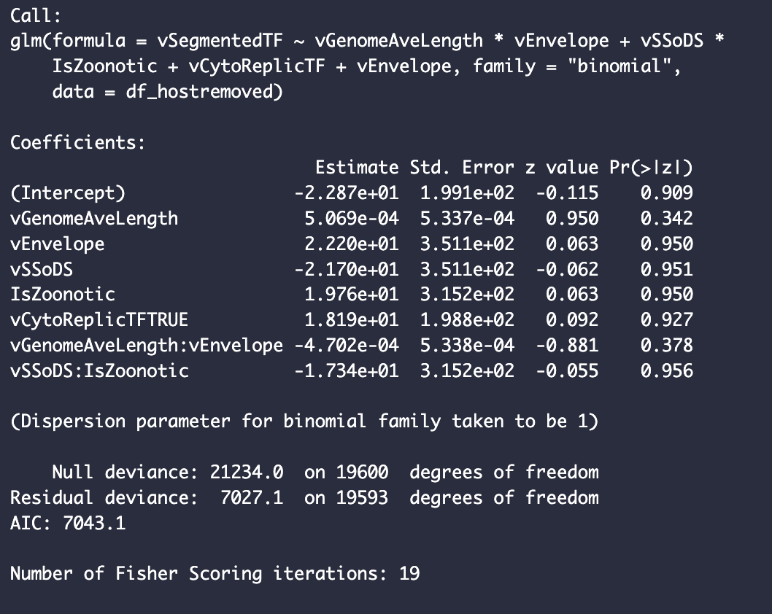
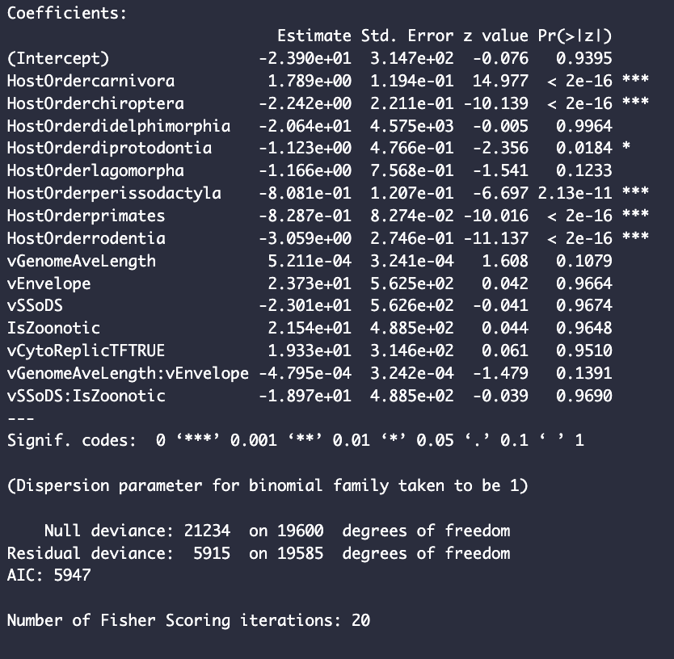
LOGISTIC REGRESSION RESULTS
Host orders are sometimes significant!
Notes:
In general, our models don’t best capture the data—but that’s not what we are investigating. In terms of AIC, we can see the inclusion of Host Order seems to improve the model. More interestingly, it is specific orders that seem to help predict for segmentation. These orders are associated with zoonotic viruses. Notably, chiroptera (bats), carnivora, rodents, primates, and perissodactyla (an order that includes horses and rhinos, which is pretty surprising)
Maybe certain host orders attack proteins responsible for segmentation

Slide 14
CONCLUSION
“Does host order act as a primary determinant of susceptibility to segmented viruses?”
“Sometimes!”
Chiroptera (bats), carnivora, primates, rodents, perissodactyla (odd-toed hoofed)
Notes:
progressive evolutionary downregulation of pathogen-sensing inflammasome pathways in Carnivora.

Slide 15
Thank you!

Slide 16
Questions?

